Slide 1
Lossless Compression

Slide 2
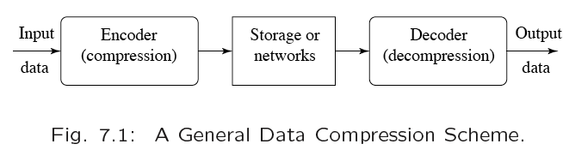
Compression
Compression: the process of coding that will effectively reduce the total number of bits needed to represent certain information.

Slide 3
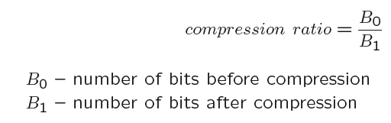
Compression
There are two main categories
  Lossless
  Lossy
Compression ratio:

Slide 4
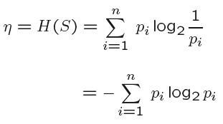
Information Theory
We define the entropy η of an information source with alphabet S = {s₁, s₂, …, s_{n}} as
p_{i} - probability that s_{i} occurs in the source and log₂1/p_{i} is amount of information in s_{i}

Slide 5
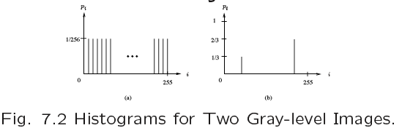
Information Theory
Figure (a) has a maximum entropy of 256 × (1/256 × log₂256) = 8.
Any other distribution has lower entropy

Slide 6
Entropy and Code Length
The entropy η gives a lower bound on the average number of bits needed to code a symbol in the alphabet
  η ≤ l where l is the average bit length of the code words produced by the encoder assuming a memoryless source

Slide 7
Run-Length Coding
Run-length coding is a very widely used and simple compression technique which does not assume a memoryless source
  We replace runs of symbols (possibly of length one) with pairs of (run-length, symbol)
  For images, the maximum run-length is the size of a row

Slide 8
Run-length coding (RLC)
(i.e., removes interpixel redunancy)
Used to reduce the size of a repeating string of characters (i.e., runs)
a a a b b b b b b c c → (a,3) (b,6) (c,2)
Encodes a run of symbols into two bytes, a count and a symbol.
Can compress any type of data but cannot achieve high compression ratios compared to other compression methods.
Dept. of Computer Science and Engineering, University of Rajshahi

Slide 9
Run-length coding
(i.e., removes interpixel redunancy)
Code each contiguous group of 0’s and 1’s, encountered in a left to right scan of a row, by its length.
1 1 1 1 1 0 0 0 0 0 0 1 → (1,5) (0,6) (1,1)
Dept. of Computer Science and Engineering, University of Rajshahi

Slide 10
Variable Length Coding
A number of compression techniques are based on the entropy ideas seen previously.
These are known as entropy coding or variable length coding
  The number of bits used to code symbols in the alphabet is variable
  Two famous entropy coding techniques are Huffman coding and Arithmetic coding

Slide 11
Huffman Coding
Huffman coding constructs a binary tree starting with the probabilities of each symbol in the alphabet
  The tree is built in a bottom-up manner
  The tree is then used to find the codeword for each symbol
  An algorithm for finding the Huffman code for a given alphabet with associated probabilities is given in the following slide

Slide 12
Huffman Coding Algorithm
Initialization: Put all symbols on a list sorted according to their frequency counts.
Repeat until the list has only one symbol left:
  a. From the list pick two symbols with the lowest frequency counts. Form a Huffman subtree that has these two symbols as child nodes and create a parent node.

Slide 13
Huffman Coding Algorithm
  b. Assign the sum of the children's frequency counts to the parent and insert it into the list such that the order is maintained.
  c. Delete the children from the list.
3. Assign a codeword for each leaf based on the path from the root.

Slide 14
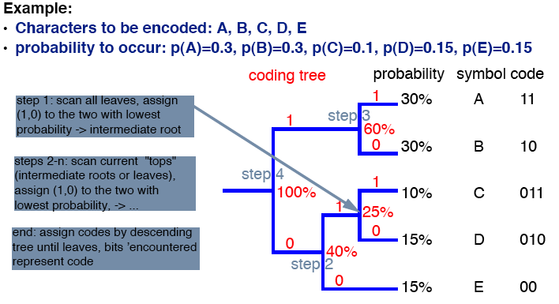
Huffman Coding Algorithm

Slide 15
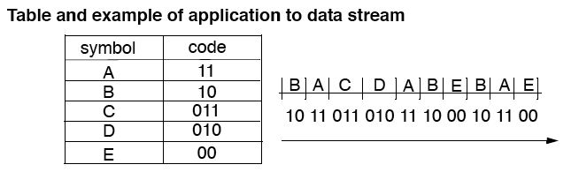
Huffman Coding Algorithm

Slide 16
Properties of Huffman Codes
No Huffman code is the prefix of any other Huffman codes so decoding is unambiguous
The Huffman coding technique is optimal (but we must know the probabilities of each symbol for this to be true)
Symbols that occur more frequently have shorter Huffman codes

Slide 17
Huffman Coding
Variants:
  In extended Huffman coding we group the symbols into k symbols giving an extended alphabet of n^{k} symbols
    This leads to somewhat better compression
  In adaptive Huffman coding we don’t assume that we know the exact probabilities
    Start with an estimate and update the tree as we encode/decode
Arithmetic Coding is a newer (and more complicated) alternative which usually performs better

Slide 18
Dictionary-based Coding
LZW uses fixed-length codewords to represent variable-length strings of symbols/characters that commonly occur together, e.g., words in English text.
The LZW encoder and decoder build up the same dictionary dynamically while receiving the data.
LZW places longer and longer repeated entries into a dictionary, and then emits the code for an element, rather than the string itself, if the element has already been placed in the dictionary.

Slide 19
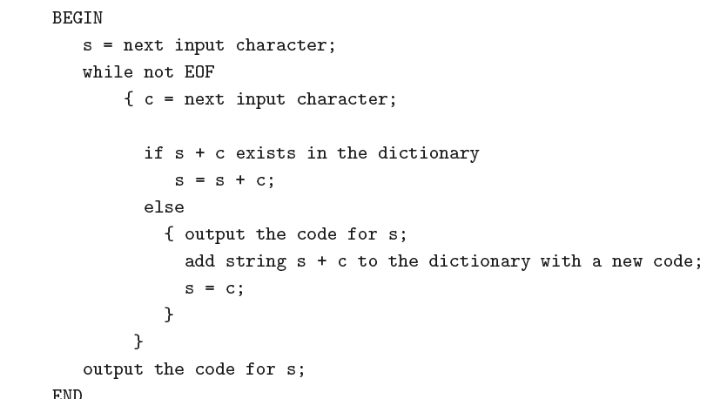
LZW Compression Algorithm

Slide 20
LZW Compression Example
We will compress the string
  "ABABBABCABABBA"
Initially the dictionary is the following

Slide 21
LZW Example
Code | String
1 | a
2 | b
2 | c

Slide 22
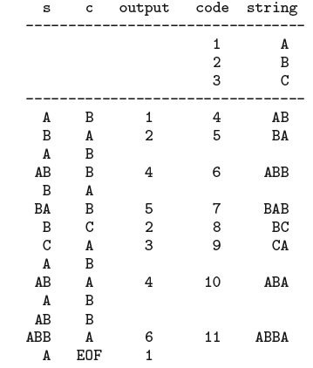
LZW Example

Slide 23
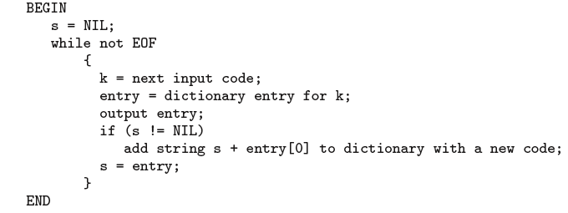
LZW Decompression

Slide 24
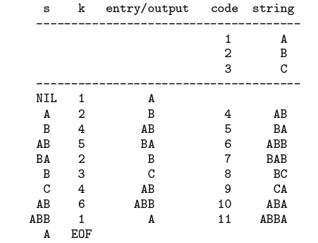
LZW Decompression Example

